Slide 1

Customer Shopping Behavior Analysis
Uncovering insights from transactional data to guide strategic business decisions.

Slide 2


Project Overview
3,900 Purchases
Uncover Insights
Analyzed transactional data across categories.
Spending patterns, segments, preferences, subscriptions.
Strategic Decisions
Guiding business growth and optimization.

Slide 3

Dataset Summary
Key Features
Data Snapshot
Customer demographics (Age, Gender, Location, Subscription)
Rows: 3,900
Purchase details (Item, Category, Amount, Season, Size, Color)
Columns: 18
Shopping behavior (Discount, Promo, Previous Purchases, Frequency, Review, Shipping)
Missing Data: 37 values in Review Rating

Slide 4

Exploratory Data Analysis (Python)
Data Loading & Initial Exploration
Pandas import, structure, and summary statistics.
Missing Data Handling
Imputed Review Rating with median by product category.
Feature Engineering
Created age_group, purchase_frequency_days.
Database Integration
Loaded cleaned data to MySQL for SQL analysis.

Slide 5
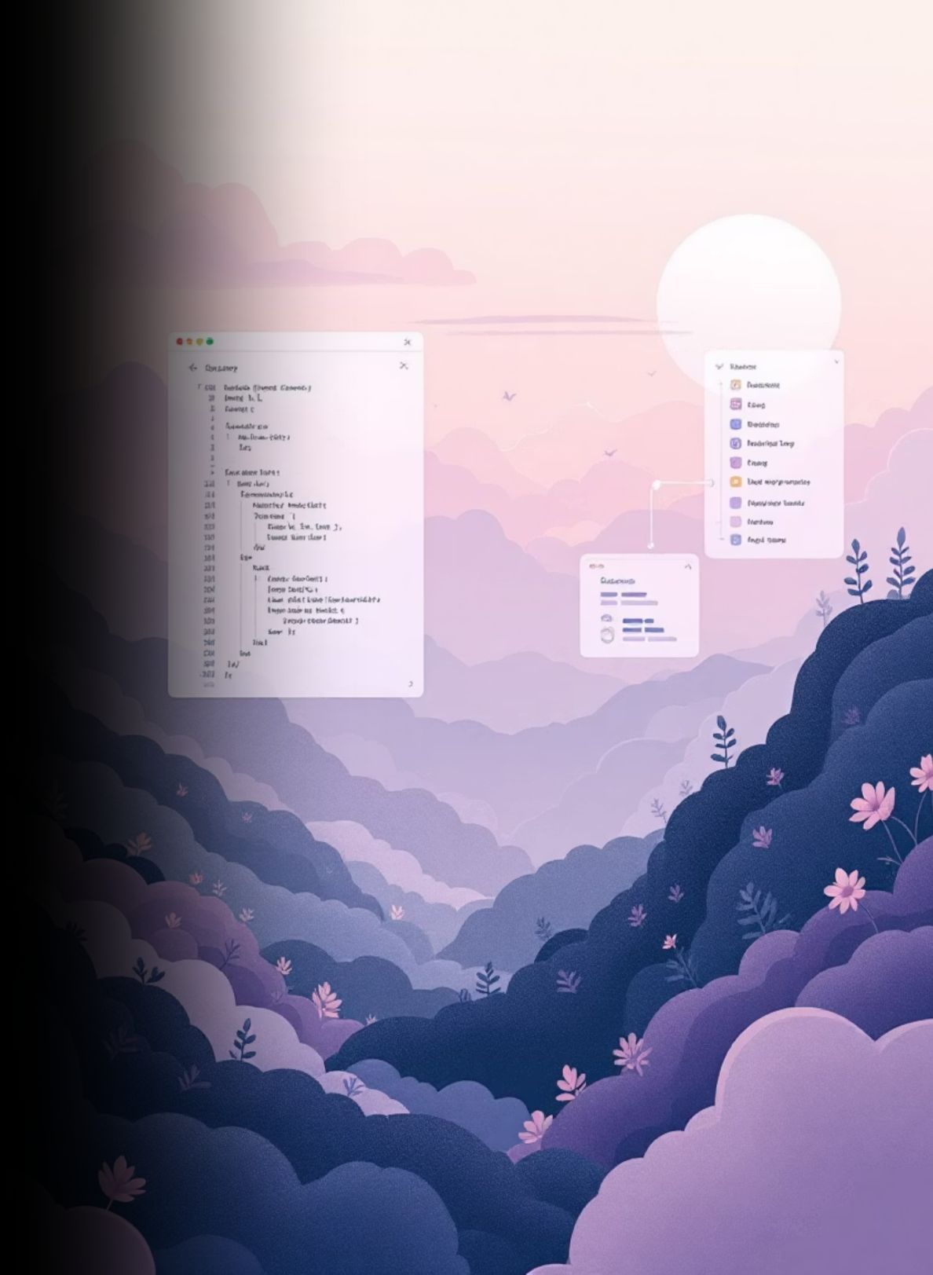
Data Analysis (SQL)
Key business questions answered through structured SQL queries.
1
Revenue by Gender
Male vs. female customer revenue comparison.
2
High-Spending Discount Users
Customers using discounts, spending above average.
3
Top 5 Products by Rating
Highest average review ratings identified.
4
Shipping Type Comparison
Average purchase amounts: Standard vs. Express.

Slide 6

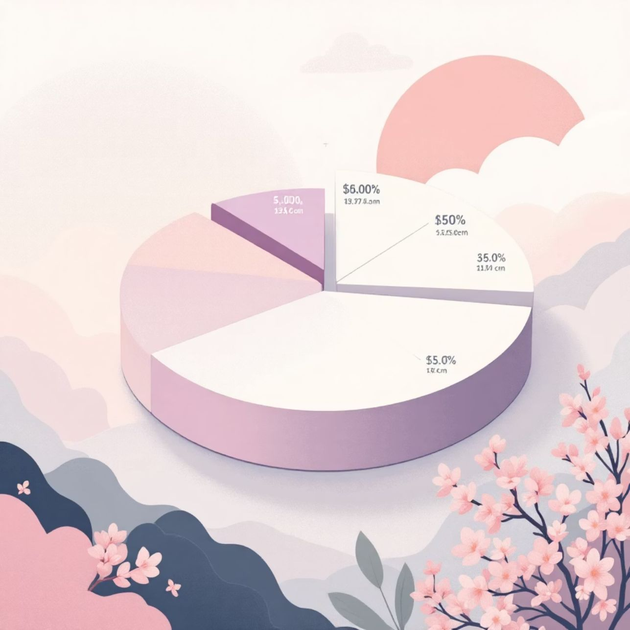
Subscription & Discount Insights
Subscribers vs. Non-Subscribers
Discount-Dependent Products
Compared average spend and total revenue.
Top 5 products with highest discounted purchases.

Slide 7



Customer Segmentation
Classifying customers based on purchase history.
Returning
Multiple purchases.
New
First-time buyers.
Loyal
Frequent, high-value purchases.

Slide 8
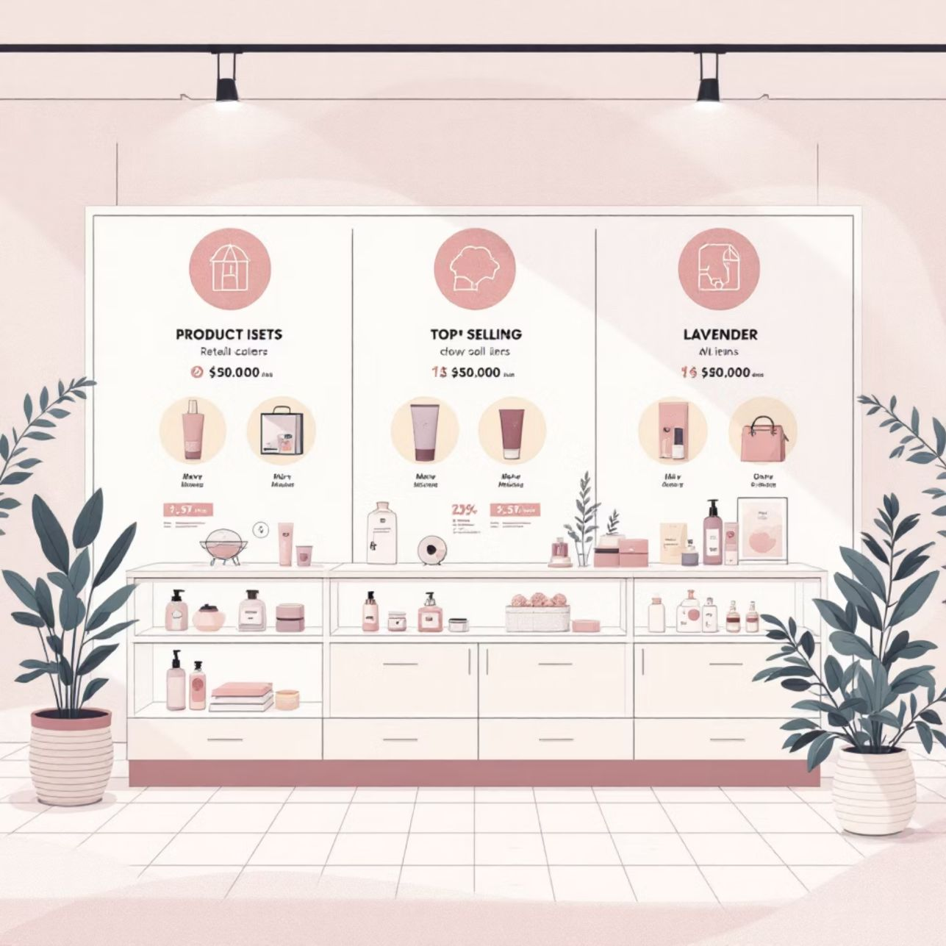

Product & Purchase Patterns
Top 3 Products per Category
Repeat Buyers & Subscriptions
Most purchased items within each category.
Customers with >5 purchases more likely to subscribe?

Slide 9
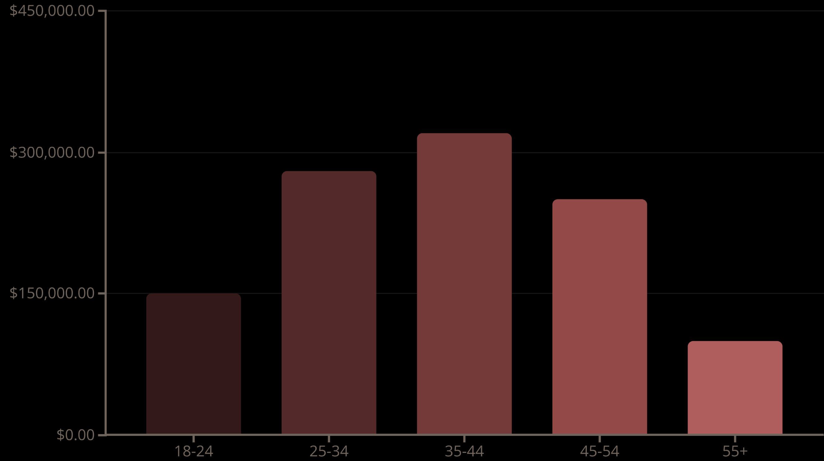
Revenue by Age Group
Total revenue contribution from each age demographic.

Slide 10

Business Recommendations
Boost Subscriptions
Promote exclusive benefits for subscribers.
Customer Loyalty Programs
Reward repeat buyers to foster loyalty.
Review Discount Policy
Balance sales boosts with margin control.
Targeted Marketing
Focus on high-revenue age groups and express-shipping users.

Slide 11
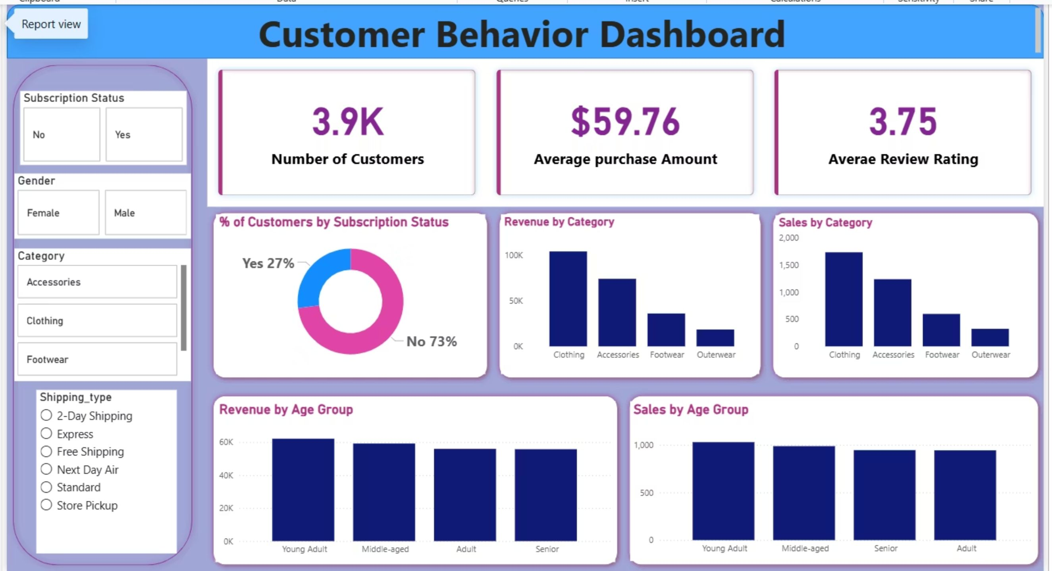
Interactive Dashboard in Power BI

